Slide 1
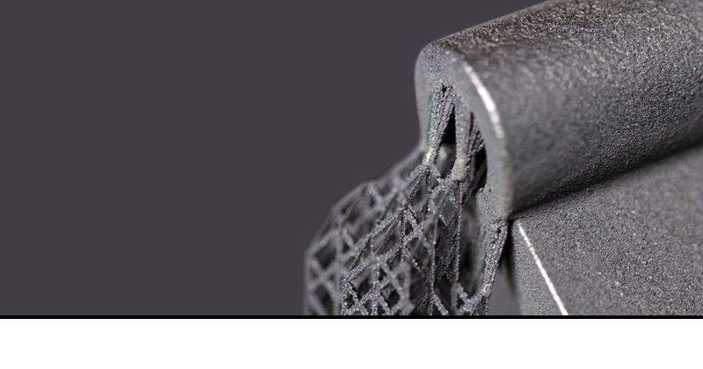
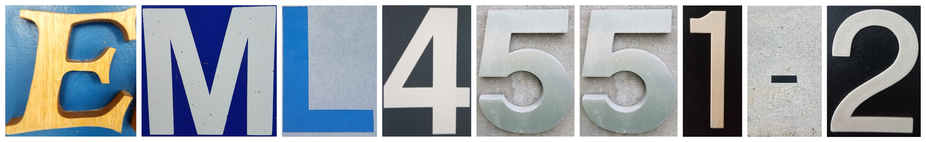
Team 501: Powder Recovery for Metal Additive Manufacturing
Arlan Ohrt
Kevin Richter
Vincent Giannetti
Noah Tipton
Joshua Dorfman
February 11th, 2019

Slide 2






Team Introductions
Noah Tipton
Vincent Giannetti
Kevin Richter
Joshua Dorfman
Arlan Ohrt
Design
Engineer
Manufacturing
Engineer
Field
Engineer
Field
Engineer
Project/Systems Engineer

Slide 3

Sponsor – Air Force Research Labs (AFRL)
AFRL/RWMW – Ordnance Division, Damage Mechanisms Branch (Eglin Air Force Base)
  A global leader in advancing weapons science and technology
Specific Contact - Dr. Philip Flater
  Lead for the metal additive manufacturing lab at AFRL/RWMW
Vincent Giannetti

Slide 4
Project Description
The objective of this project is to design a device which increases the amount of recovered steel powder in a metal additive manufacturing process. This device should be compatible with existing hardware and processes while ensuring the safety of the operators.
Vincent Giannetti

Slide 5


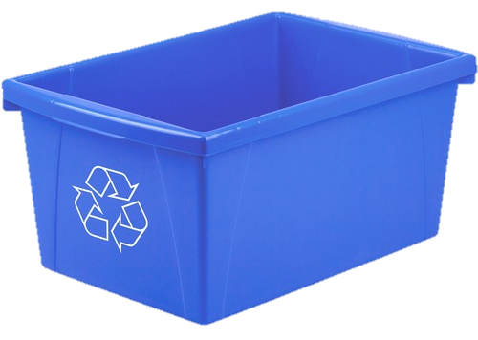
The Three ‘R’s
Recycle
Recover
Remove
Vincent Giannetti

Slide 6
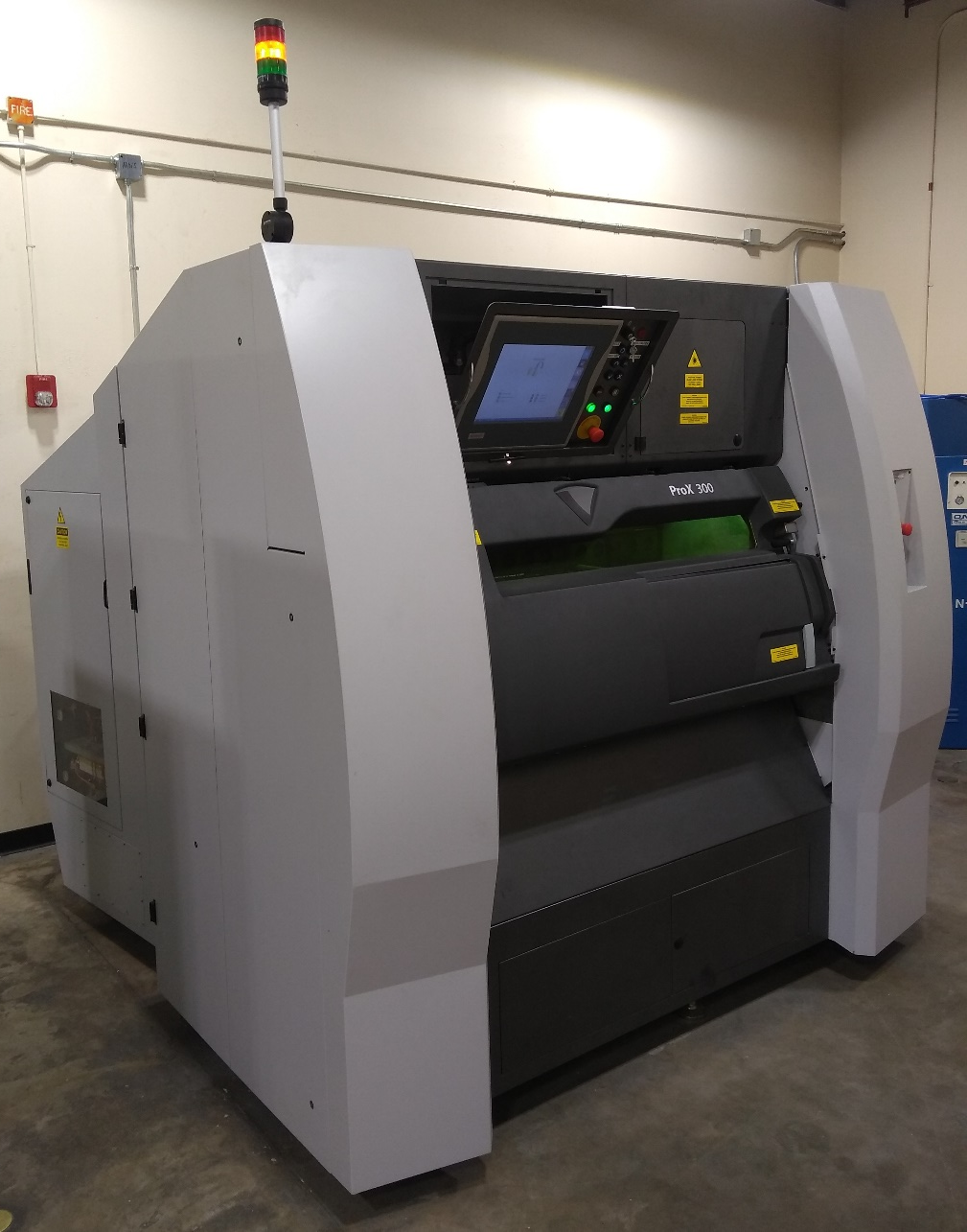
Project Background – Metal Additive Manufacturing
Laser Powder Bed Fusion (LPBF):
Powder Distributed in an Even Layer
Laser Traces Layer Path to “Fuse” Material Together
This process results in a large amount of “unfused” powder. This powder should be recycled.
AFRL’s operating 3D printer is the 3D Systems ProX 300
Vincent Giannetti

Slide 7
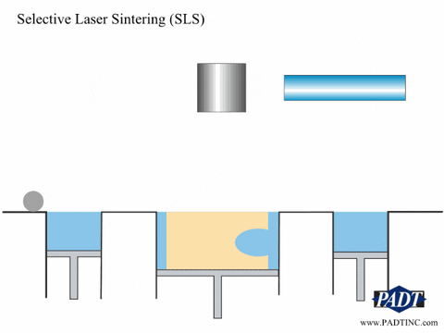
Project Background – Metal Additive Manufacturing
Laser Powder Bed Fusion (LPBF):
Powder Distributed in an Even Layer
Laser Traces Layer Path to “Fuse” Material Together
This process results in a large amount of “unfused” powder. This powder should be recycled.
Vincent Giannetti

Slide 8
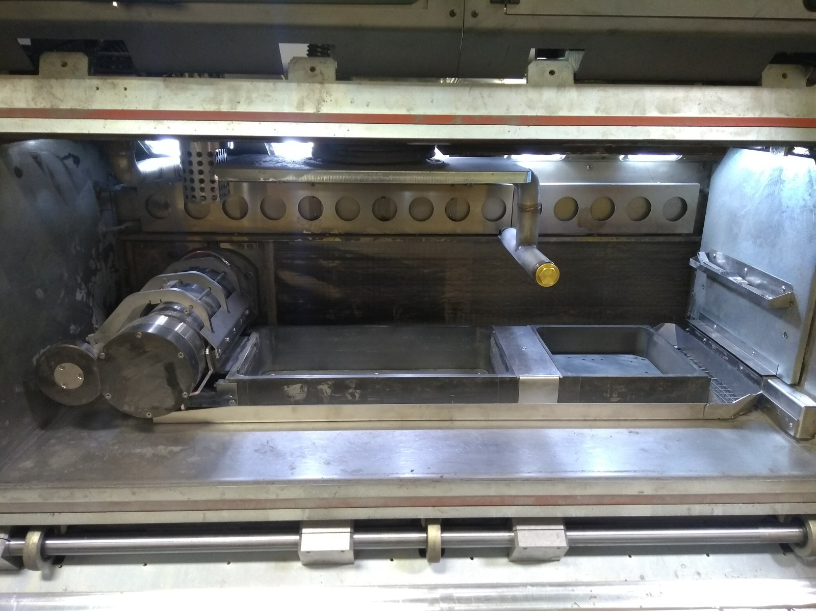
Project Background – Metal Additive Manufacturing
Powder Supply
Build Plate
Roller
Overflow
Vincent Giannetti

Slide 9
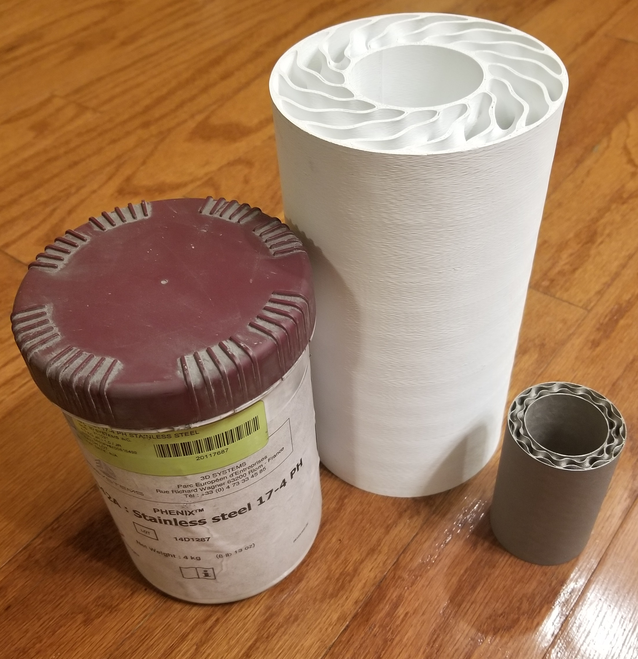
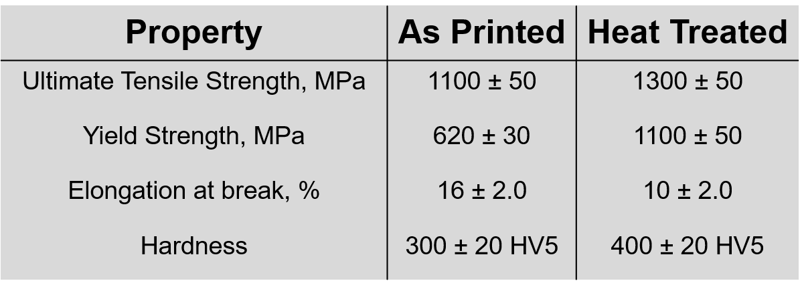
Project Background – The Metal Used
17– 4PH Stainless Steel: 17% Chromium, 4% Nickel, Precipitation Hardening
General Info:
Purchasable from 3D Systems
Particle Size: 10 – 15 μm (Paper thickness is ~ 100 μm)
Martensitic Steel (Magnetic)
Vincent Giannetti

Slide 10

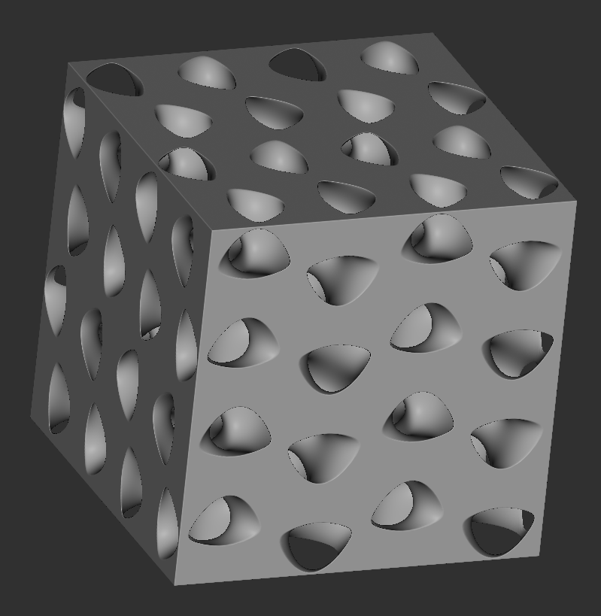
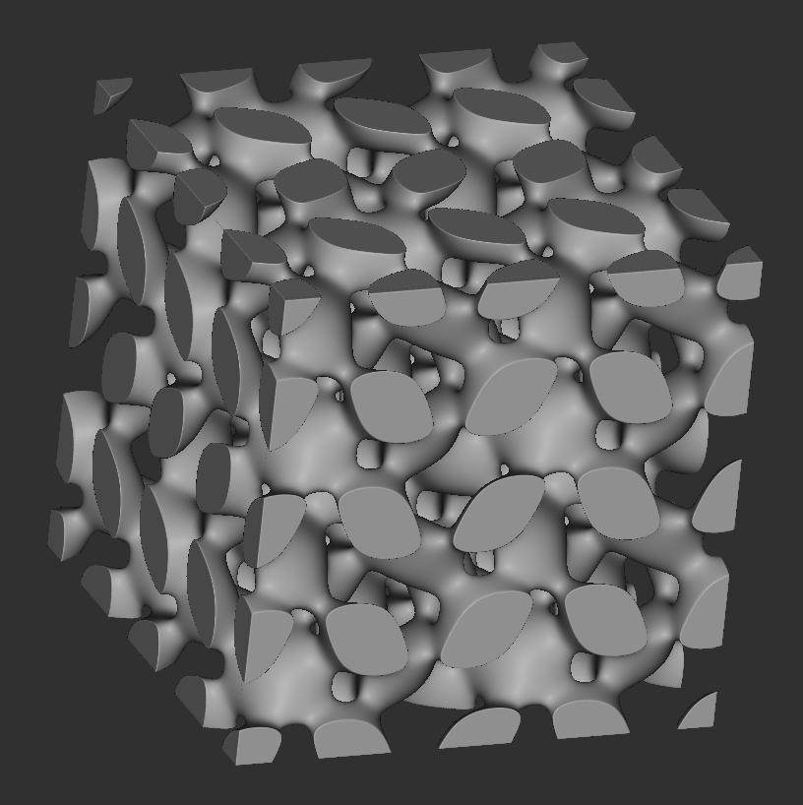
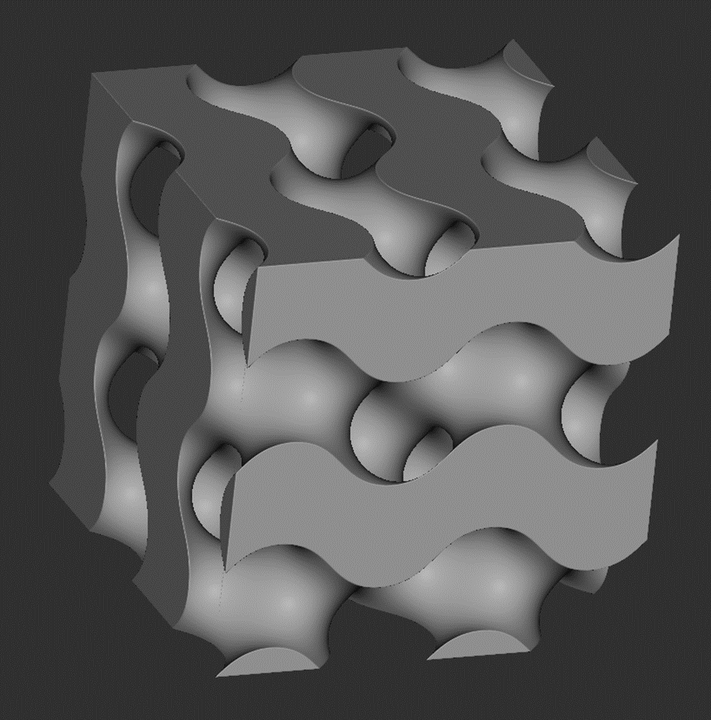
Project Background – The Metal Used
17– 4PH Stainless Steel: 17% Chromium, 4% Nickel, Precipitation Hardening
General Info:
Purchasable from 3D Systems
Particle Size: 10 – 15 μm (Paper thickness is ~ 100 μm)
Martensitic Steel (Magnetic)
Vincent Giannetti

Slide 11
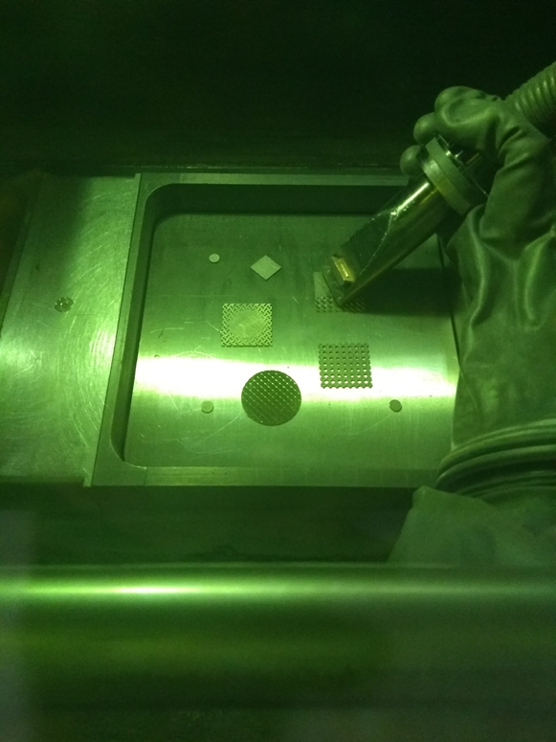
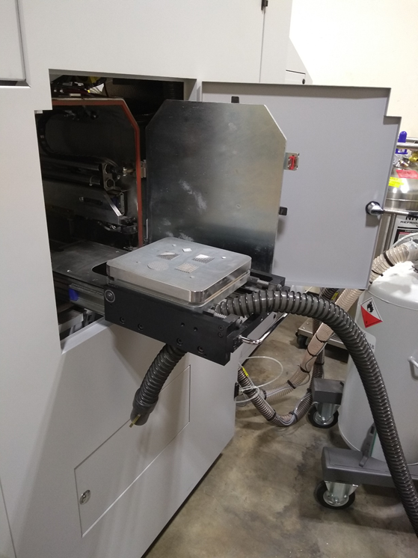
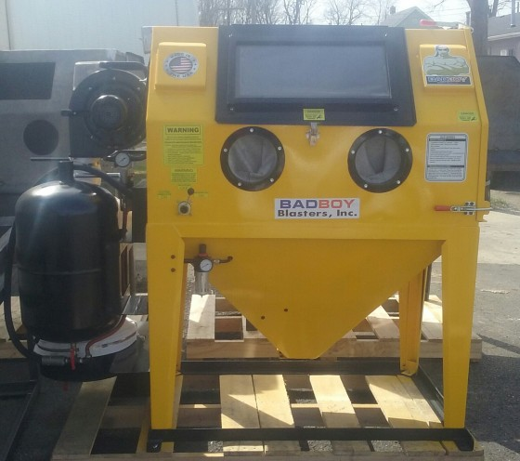
Project Background – Powder Recovery Stages
“Built In Stage”
“Wet Vac Stage”
“Air Powered Stage”
Vincent Giannetti

Slide 12
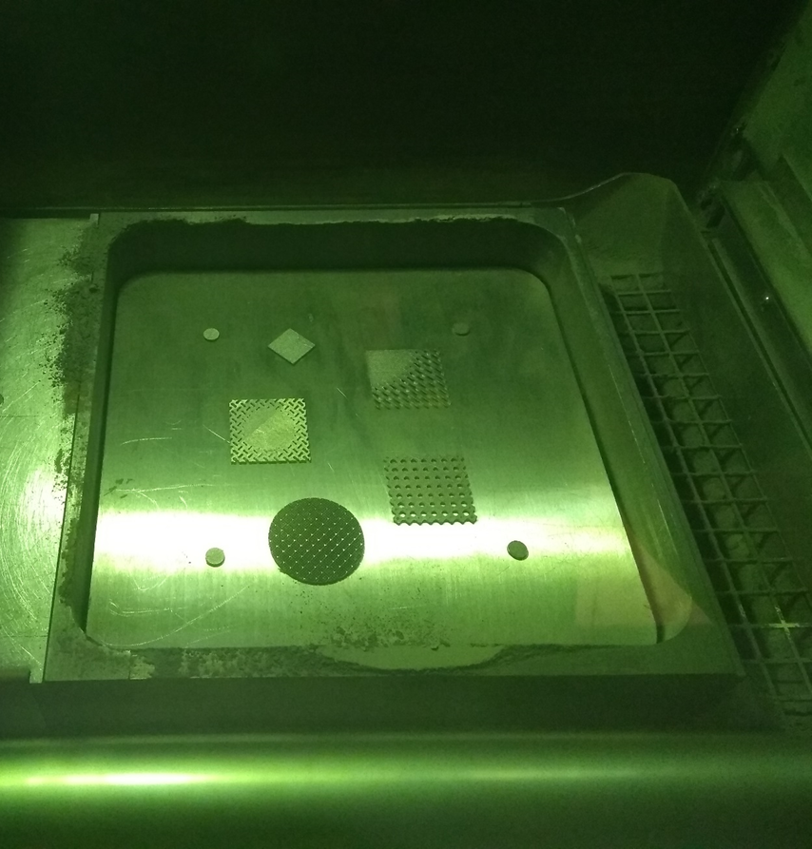
Project Background – Powder Recovery Stages
Stage 1 – “Built In Stage”
Built in recovery system
  Vacuum
  Overflow Reservoir
Operation
  Sealed chamber
  Glove to operate vacuum
Substantial Powder Recovery
Vincent Giannetti

Slide 13
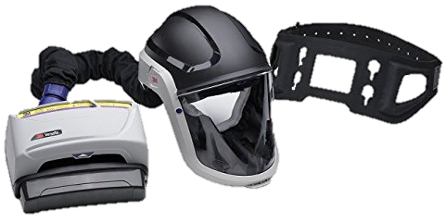
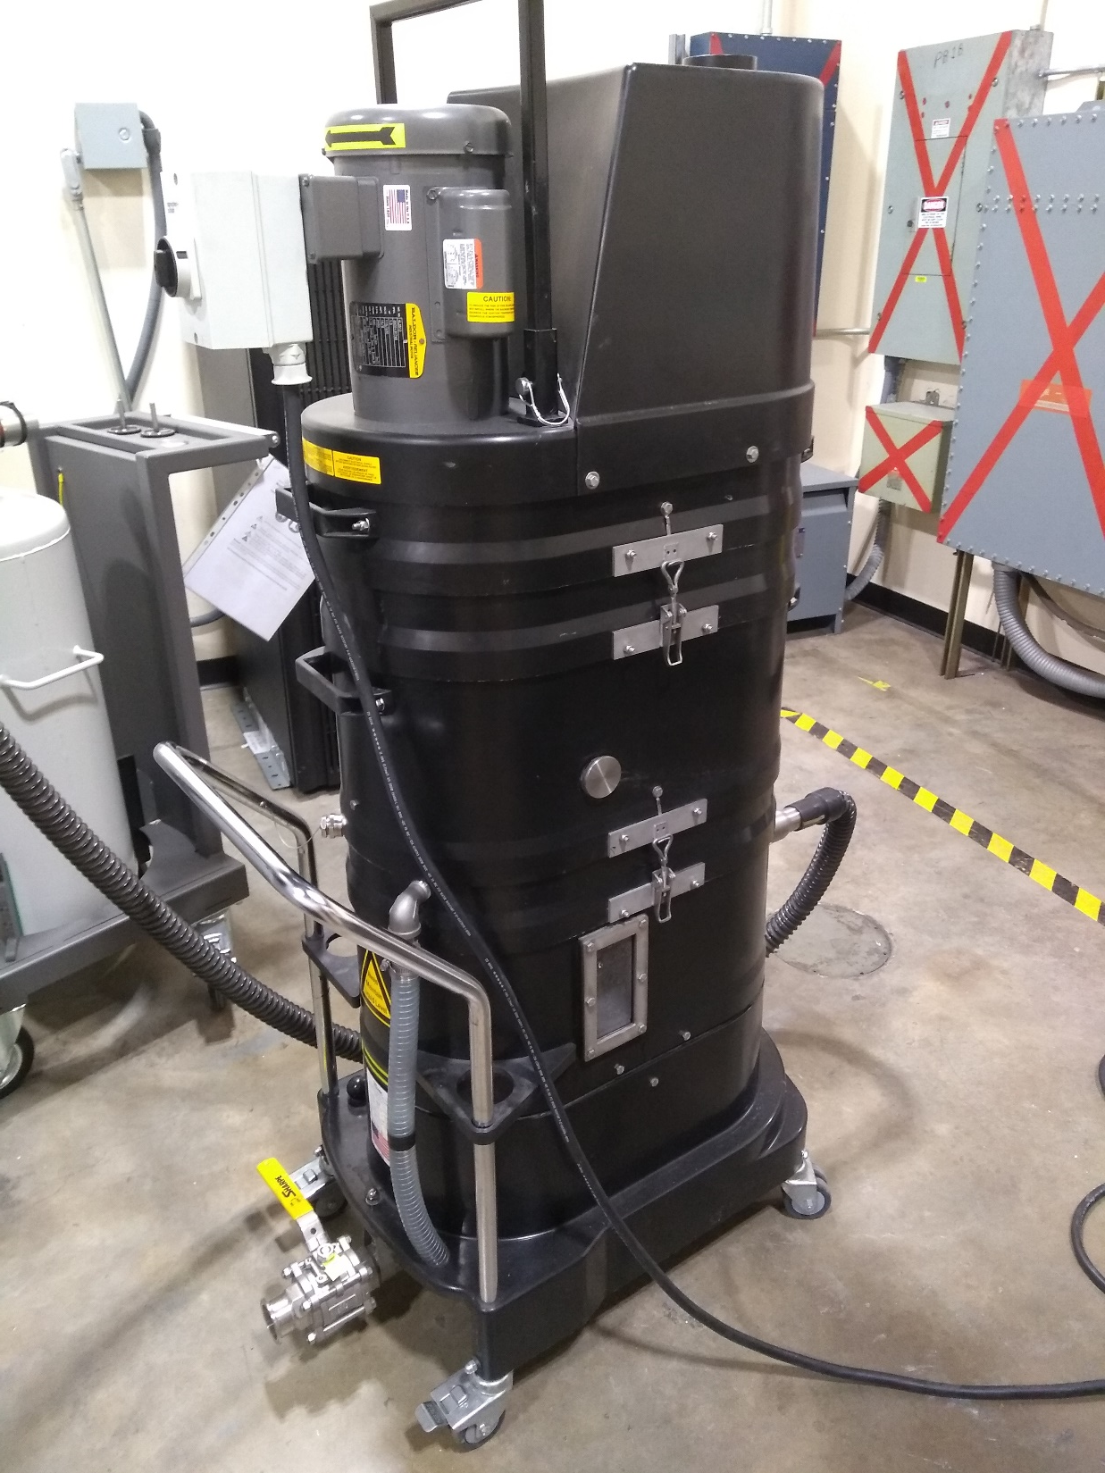
Project Background – Powder Recovery Stages
Stage 2 – “Wet Vac Stage”
Removing the part
  Pass the build plate out
Operation
  Use powered air purifying respirator (PAPR)
  Open door and remove part
  Use Ruwac NA35 Immersion Vacuum
No Powder Recovery
Vincent Giannetti

Slide 14
Project Background – Powder Recovery Stages
Stage 3 – “Air Powered Stage”
Sandblasting cabinet
Operation
  Place part inside the enclosure
  Use compressed air to remove residual powder
No Powder Recovery
Vincent Giannetti

Slide 15
“Our System”
Significant Powder Recovery
Project Background – Powder Recovery Stages
Substantial Powder Recovery
No Powder Recovery
No Powder Recovery
“Built In Stage”
“Wet Vac Stage”
“Air Powered Stage”
Vincent Giannetti

Slide 16
Project Background – Powder Recovery Stages
“Our System”
Significant Powder Recovery
Substantial Powder Recovery
No Powder Recovery
No Powder Recovery
“Built In Stage”
“Wet Vac Stage”
“Air Powered Stage”
Vincent Giannetti

Slide 17
New System
~2 feet
Three Main Components
1. Supporting Frame
2. Vibration Dampeners
3. Part Holder and Vibrator
Build Plate and Part
Fasteners
Vibrator
Kevin Richter

Slide 18
New System
~2 feet
Three Main Components
1. Supporting Frame
2. Vibration Dampeners
3. Part Holder and Vibrator
Build Plate and Part
Fasteners
Vibrator
Kevin Richter

Slide 19
New System
Three Main Components
1. Supporting Frame
2. Vibration Dampeners
3. Part Holder and Vibrator
Build Plate and Part
Fasteners
Vibrator
Kevin Richter

Slide 20
New System
Three Main Components
1. Supporting Frame
2. Vibration Dampeners
3. Part Holder and Vibrator
Build Plate and Part
Fasteners
Vibrator
Kevin Richter

Slide 21
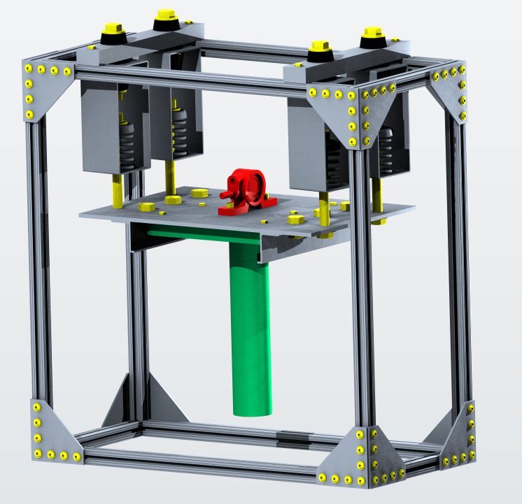
New System
Three Main Components
1. Supporting Frame
2. Vibration Dampeners
3. Part Holder and Vibrator
Build Plate and Part
Fasteners
Vibrator
Kevin Richter

Slide 22

New System
Build Plate and Part
Fasteners
Vibrator
Kevin Richter
What About Safety?

Slide 23
Build Plate and Part
Fasteners
Vibrator
New System
What About Safety?
Kevin Richter

Slide 24
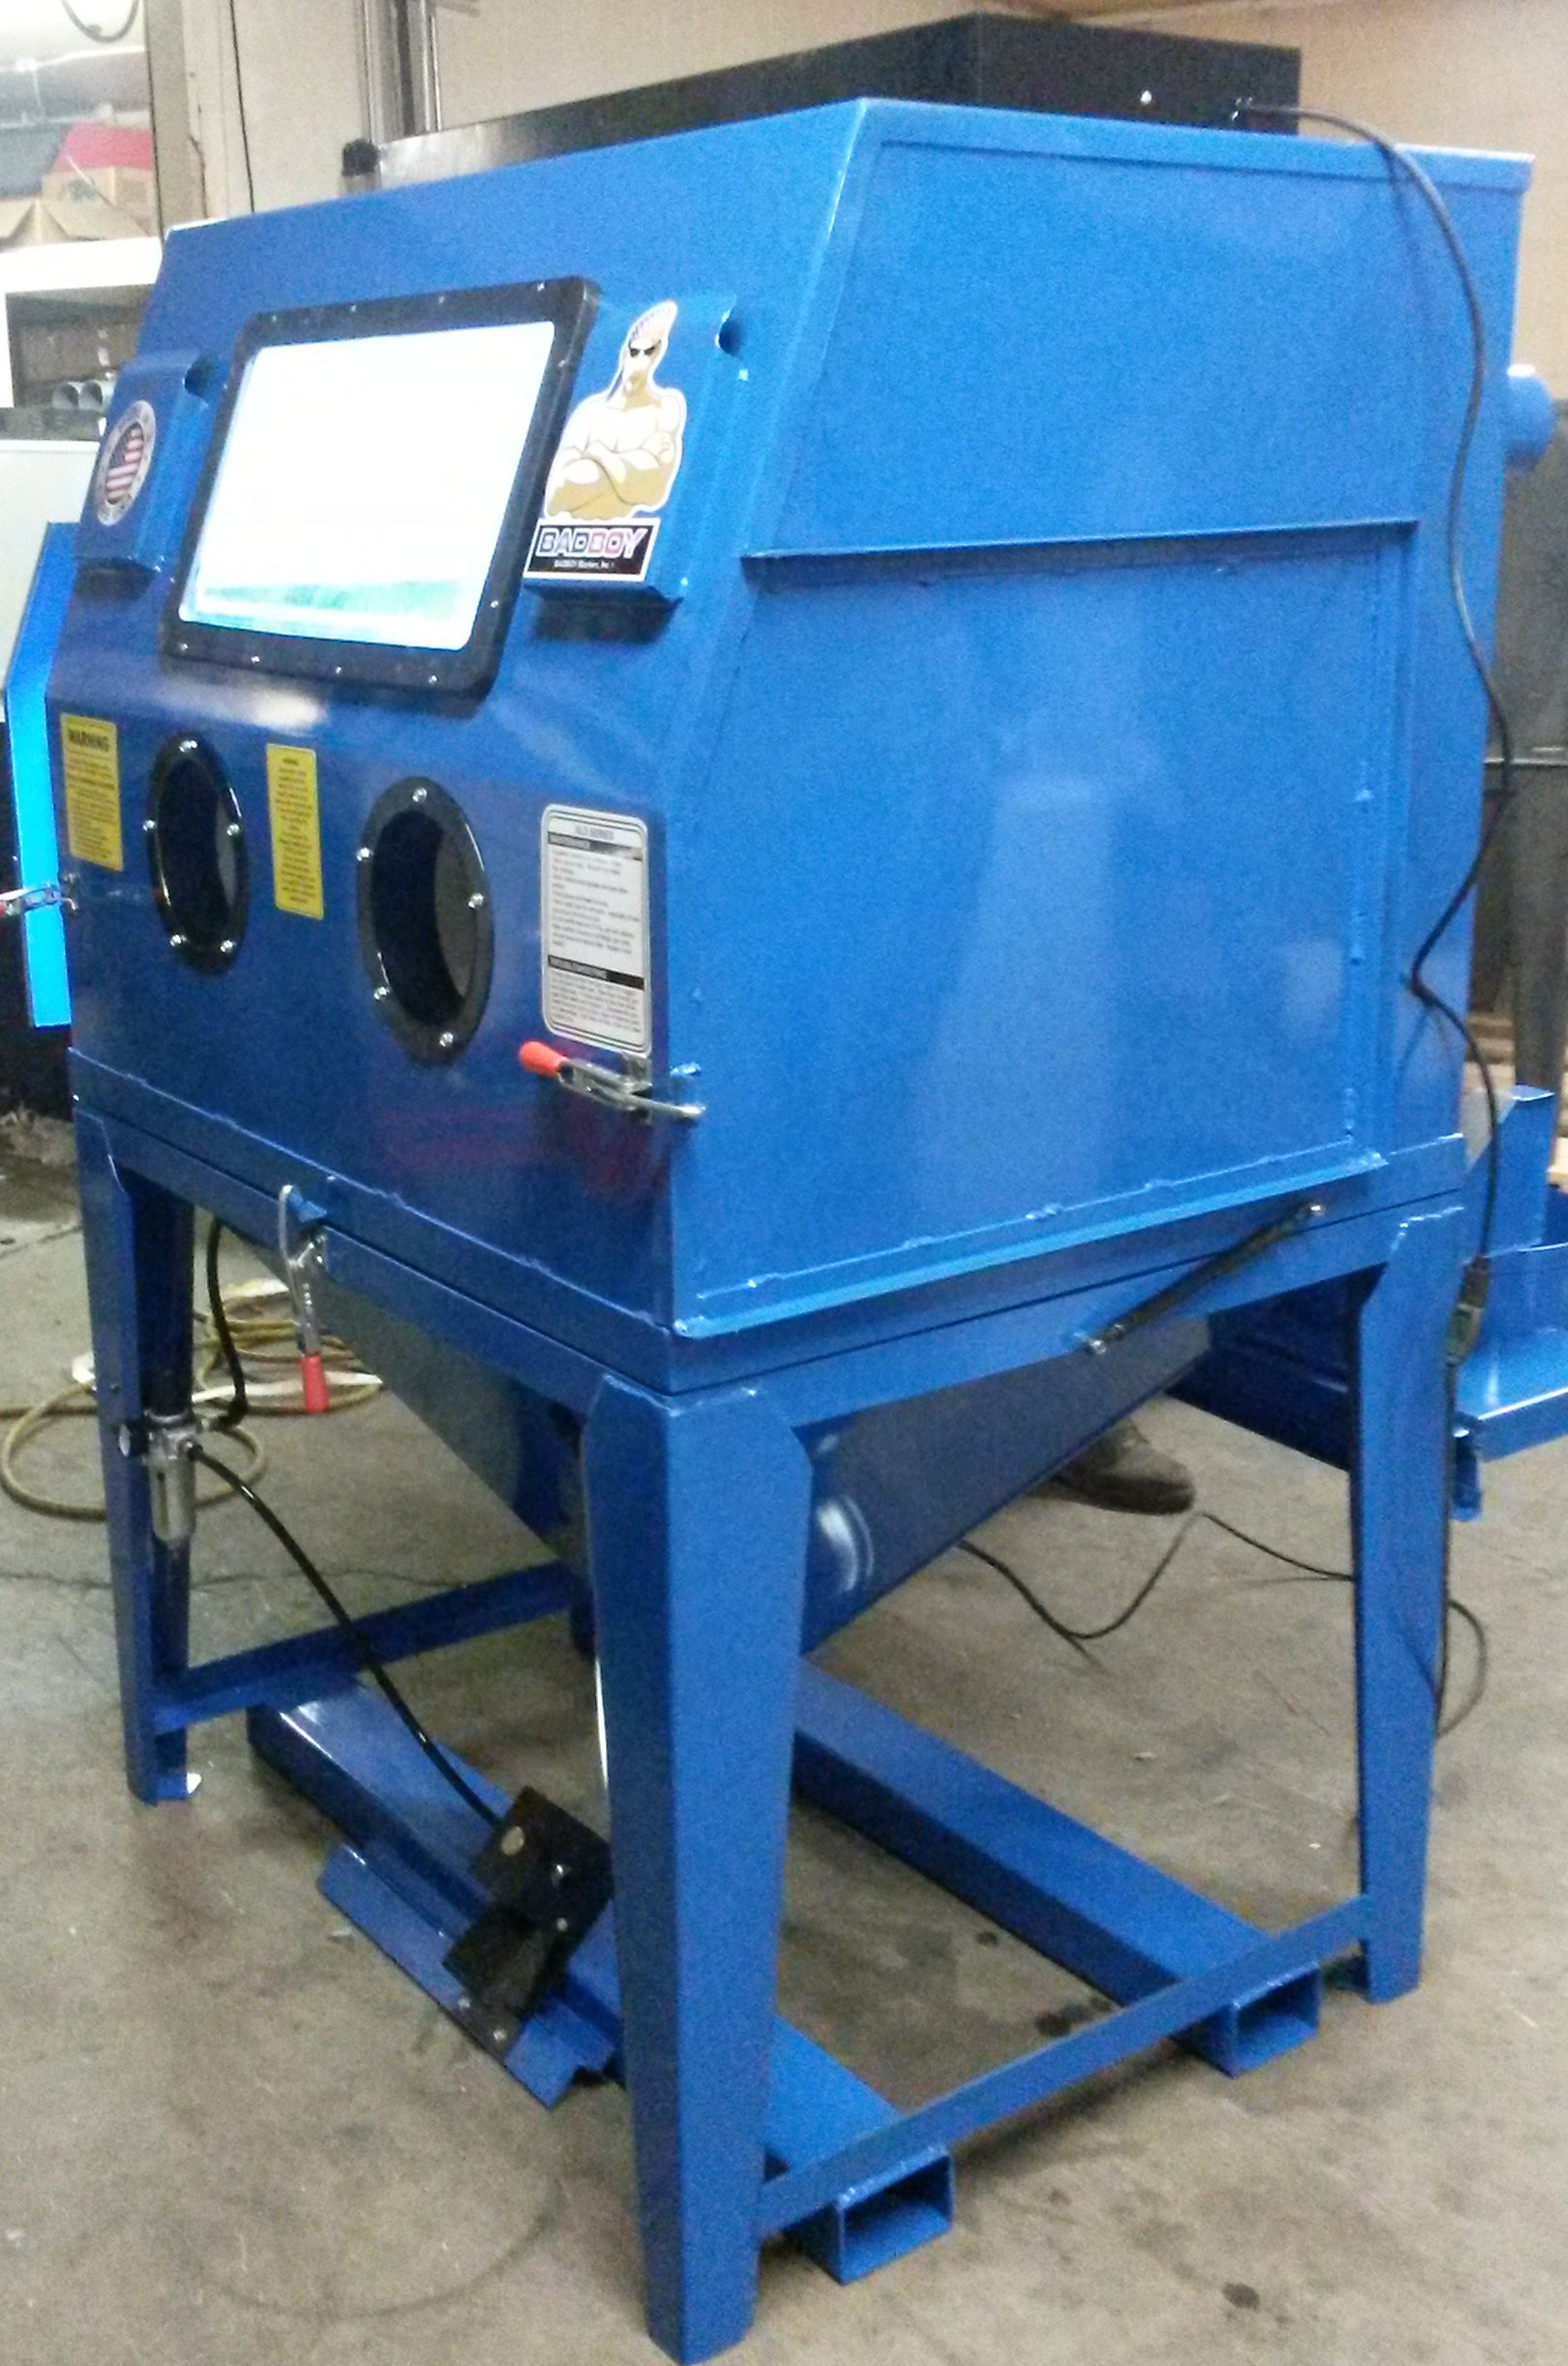
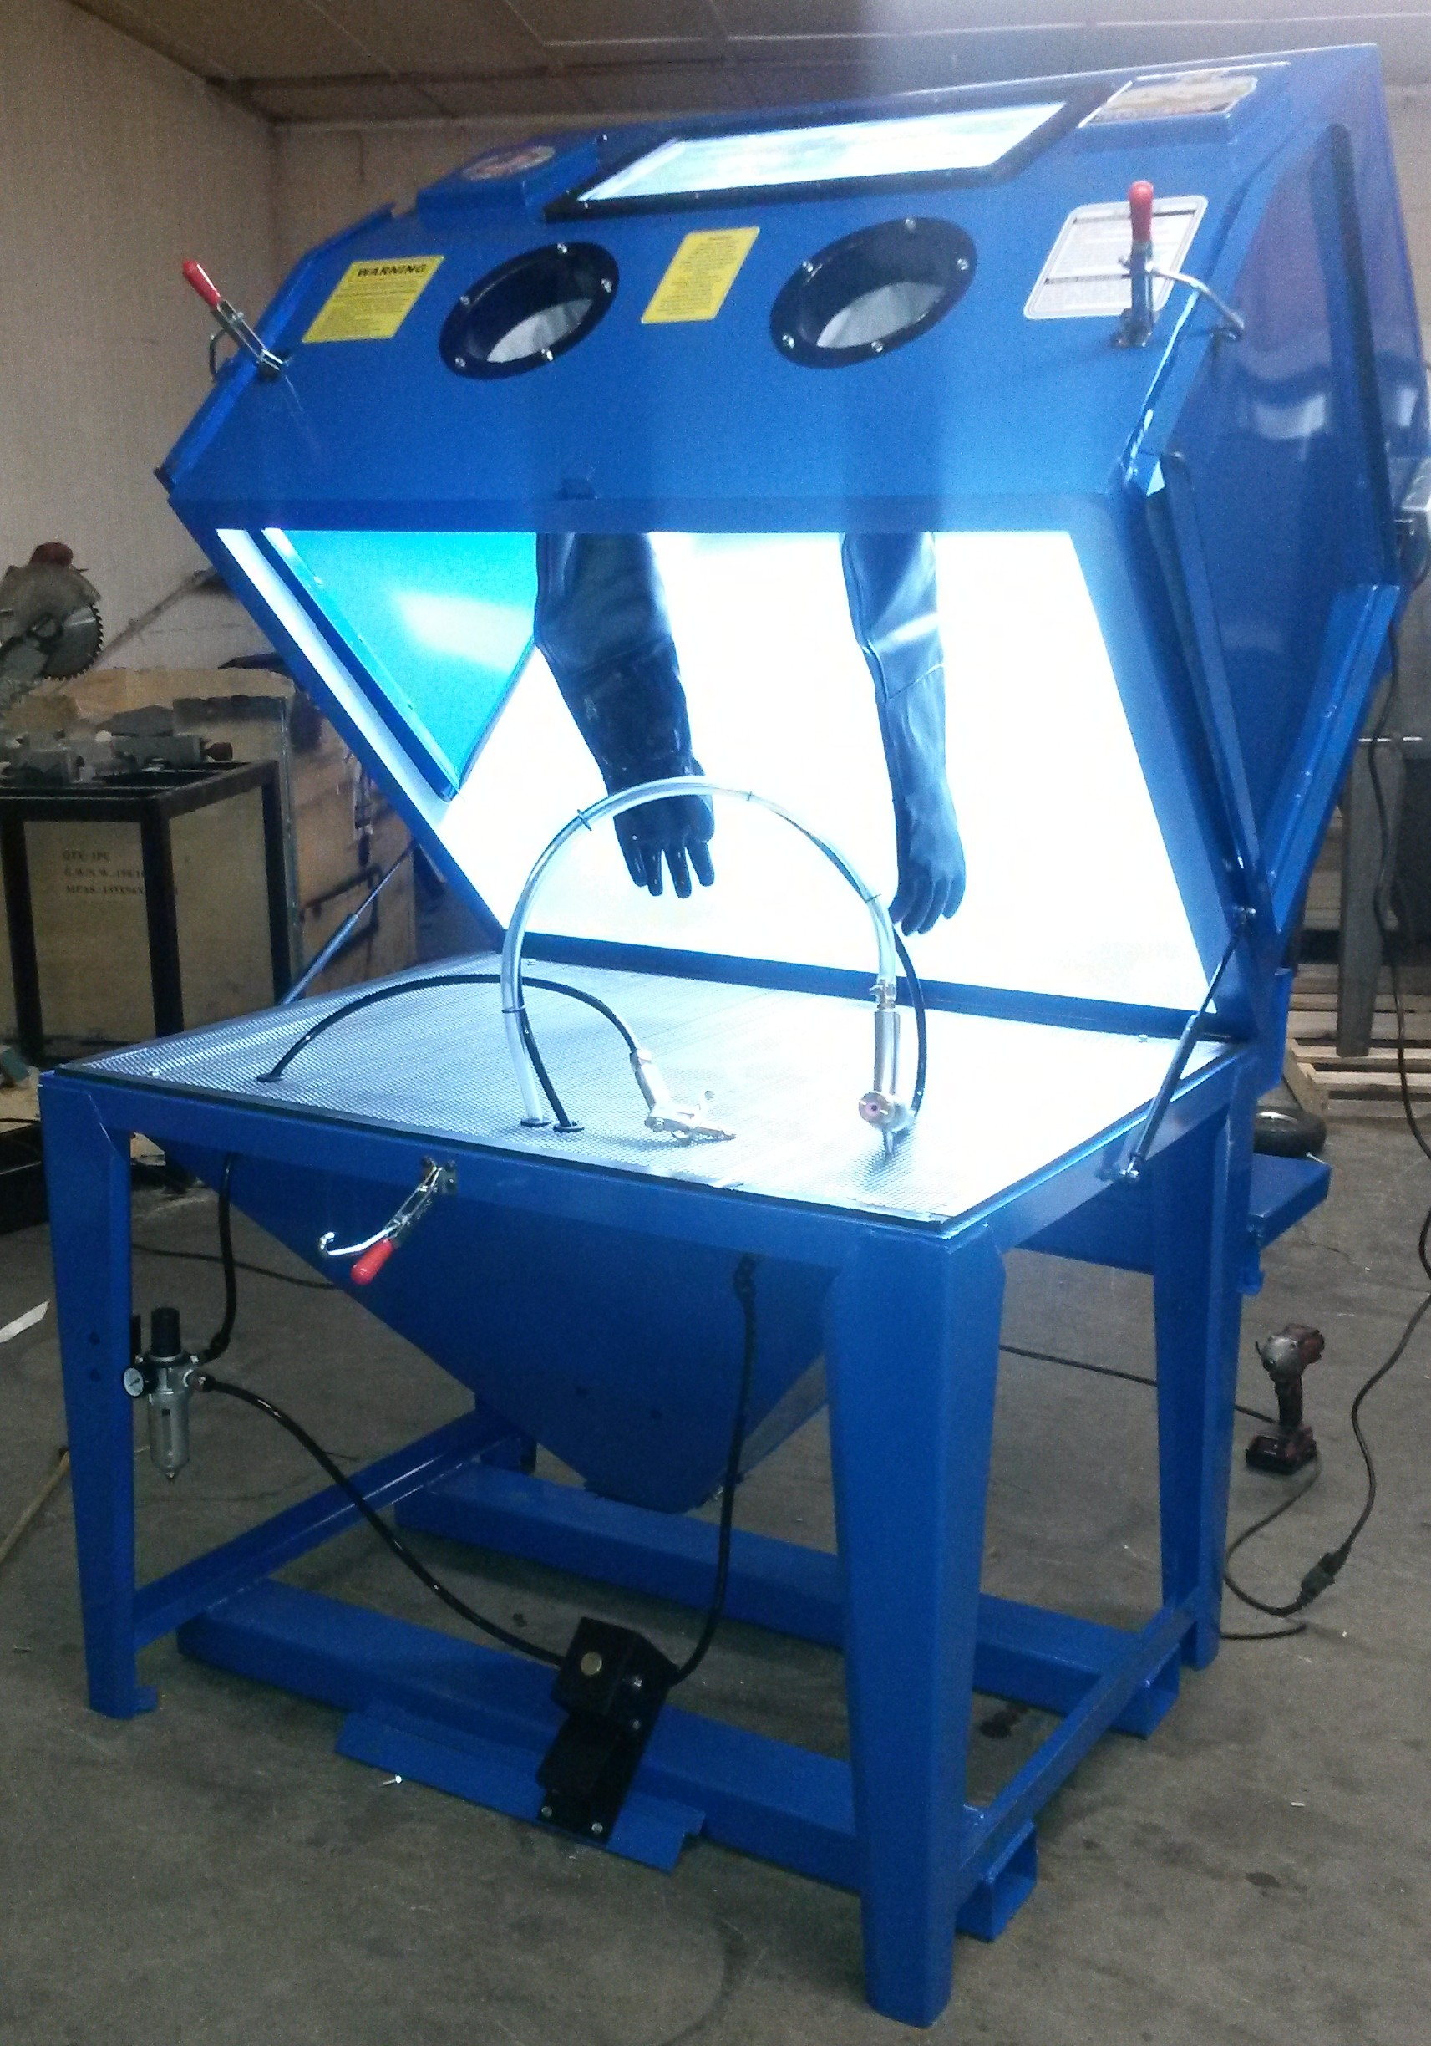
New System
Barrier Needed to Control Powder
BADBOY Blaster
Clamshell Design
Fits Design Well
Industrial Quality
What About Safety?
Kevin Richter

Slide 25
Chosen Barrier
Barrier Needed to Control Powder
BADBOY Blaster
Clamshell Design
Fits Design Well
Industrial Quality
What About Safety?
Kevin Richter

Slide 26
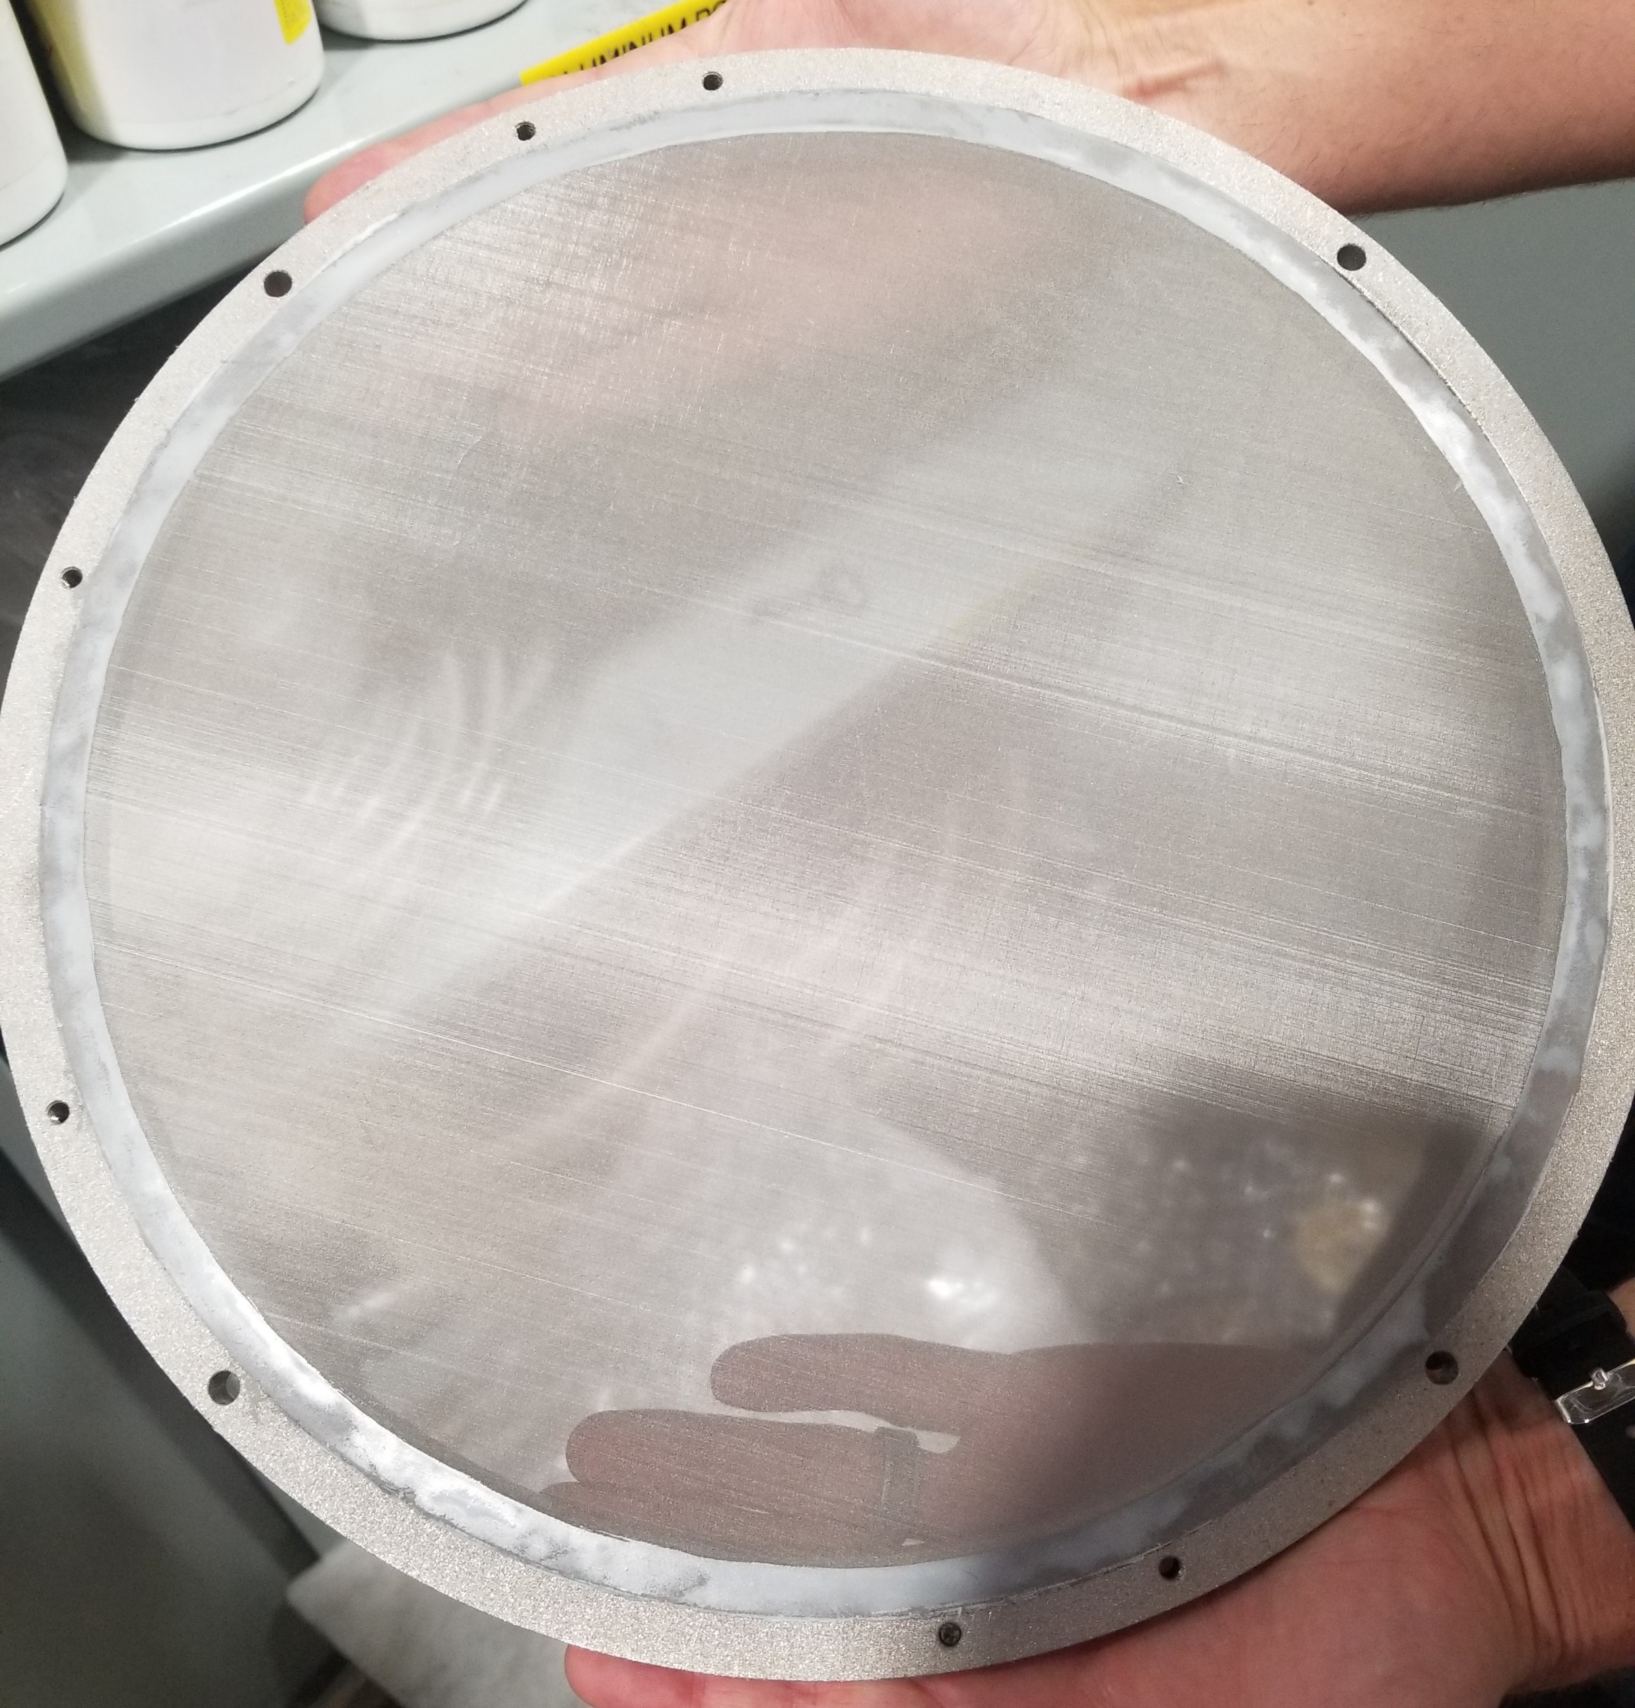
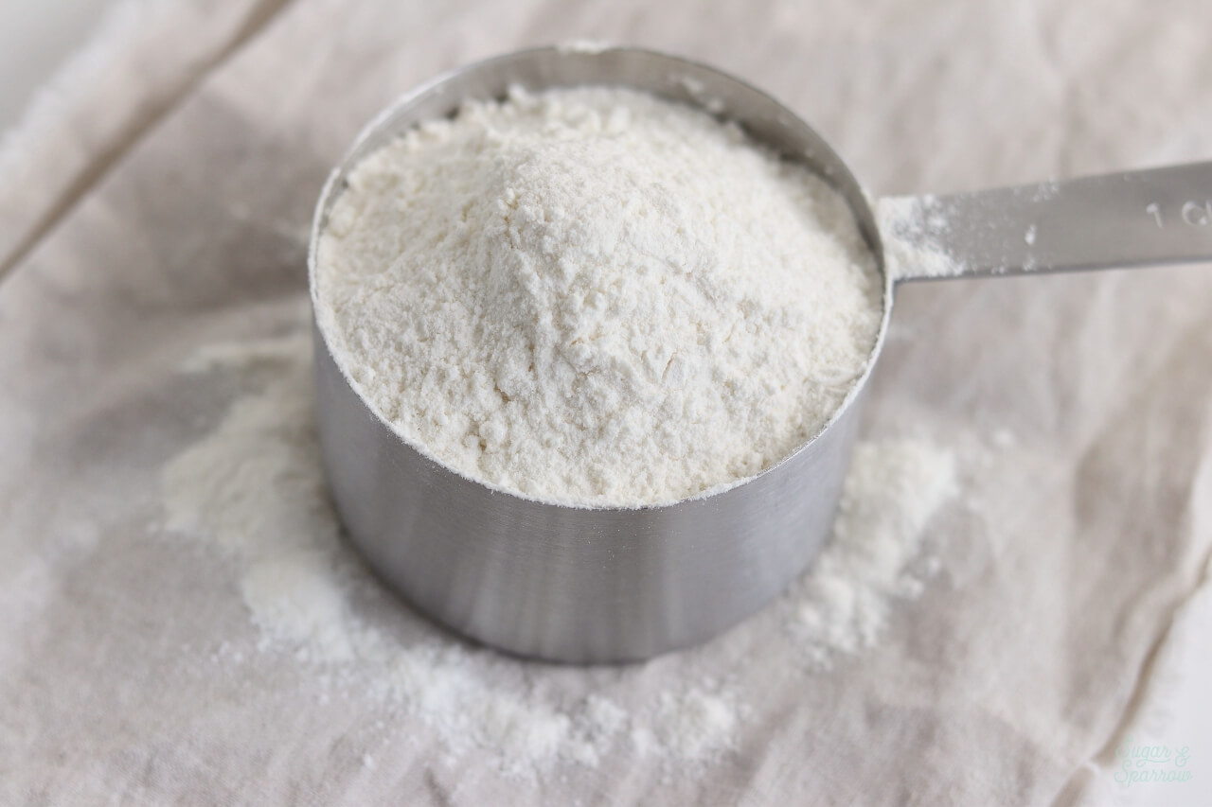
Main Components of Validation
Three Main Components
1. Safety
2. Test Powder
3. Test Part
Safety and Powder
Any powder under 5 μm is harmful
A non-metallic powder like flour is relatively safer to inhale
75 μm Mesh
Flour: 25 – 400 μm
Kevin Richter

Slide 27
Scaled 4x
Main Components of Validation
Three Main Components
1. Safety
2. Test Powder
3. Test Part
Safety and Powder
Any powder under 5 μm is harmful
A non-metallic powder like flour is relatively safer to inhale
75 μm Mesh
Flour: 25 – 400 μm
Kevin Richter

Slide 28
Main Components of Validation
Three Main Components
1. Safety
2. Test Powder
3. Test Part
Safety and Powder
Any powder under 5 μm is harmful
A common material provides benefits
A non-metallic or wood powder is safer based on codes
Scaled 4x
75 μm Mesh
Flour: 25 – 400 μm
Kevin Richter

Slide 29
Current Work
Management & Deliverables
Arlan Ohrt
Complete Statics Analysis
Noah Tipton
Complete Dynamics Analysis
Vincent Giannetti
Assembly & Fabrication
Kevin Richter
Joshua Dorfman
Testing Preparation
Kevin Richter
Joshua Dorfman
Kevin Richter

Slide 30
References
Title Slide Background - https://www.materialise.com/en/blog/when-how-and-where-of-metal-3d-printing
Lost and Found - https://www.portseattle.org/sites/default/files/2019-08/bigstock_lost_1140.jpg?slideshow=true&slideshowAuto=false&slideshowSpeed=4000&speed=350&transition=elastic
Recycle Bin - http://fridandrussell.com/SH_productdetail.asp?Ino=61517U06C&Company=STX
Painter’s Tape - https://www.scotchblue.com/3M/en_US/scotchblue/proper-tape-removal/
3D Systems – https://www.3dsystems.com/3d-printers/prox-dmp-300/specifications
LPBF Demo GIF - https://thescopepopculturescience.blogspot.com/2015_01_01_archive.html
Stainless Steel Properties - https://www.3dsystems.com/materials/metal
nTopology – https://ntopology.com/
PAPR – https://images-na.ssl-images-amazon.com/images/I/4125zPcBPNL.jpg
Sandblaster - https://badboyblasters.com/product/abrasive-media-sand-blaster-bb1050led-bvr-pr-hv-fl-2/
AFRL Sign - https://news.wfsu.org/post/eglin-air-force-base-ready-adjust-hiring-freeze
Electric Vibrator - https://www.mcmaster.com/5808k61
Dampeners - https://www.mcmaster.com/29895t54 , https://www.mcmaster.com/9241k44
Flour - https://sugarandsparrow.com/homemade-cake-flour-recipe/

Slide 31
Team 501: Powder Recovery for Metal Additive Manufacturing
Arlan Ohrt
Kevin Richter
Vincent Giannetti
Noah Tipton
Joshua Dorfman
February 11th, 2019

Slide 32
Backup Slides
3D Systems Printer Specs
Functional Decomposition
Precipitation Hardening Explained
Group Member Contact
17- 4PH Material
nTopology
Return

Slide 33
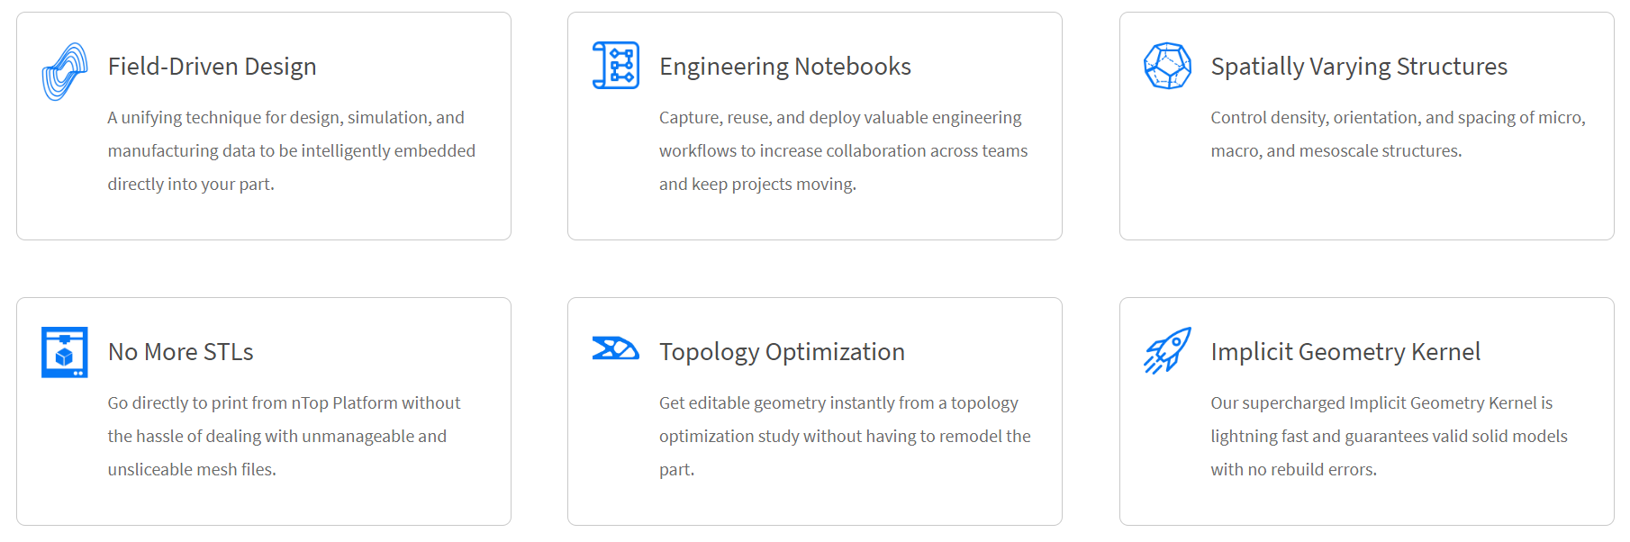
Return

Slide 34
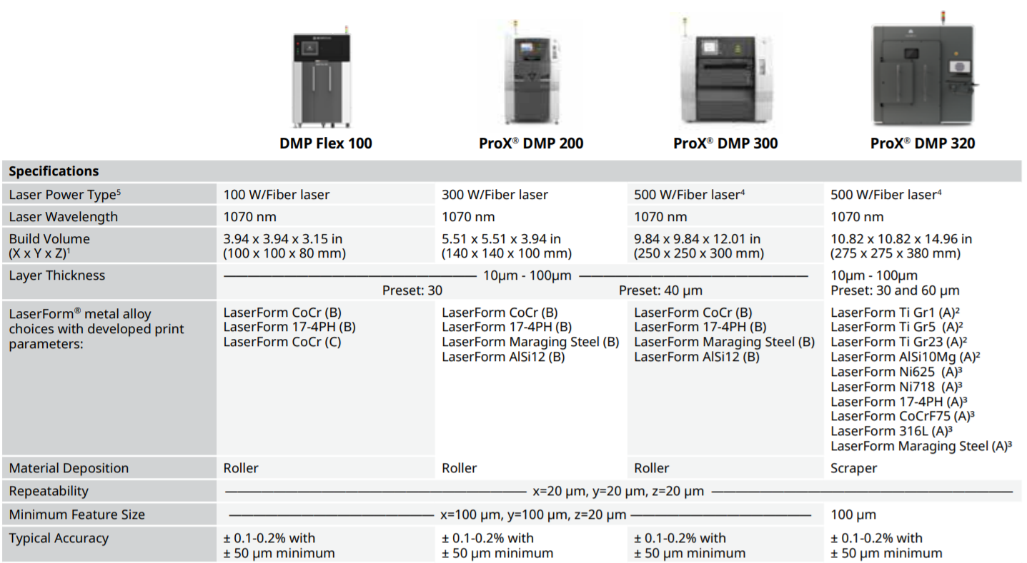
Return

Slide 35
Group Contact
Vincent Giannetti
Noah Tipton
Joshua Dorfman
Arlan Ohrt
Kevin Richter
vjg15b@my.fsu.edu
nrt15@my.fsu.edu
jd16s@my.fsu.edu
ago16b@my.fsu.edu
kr15@my.fsu.edu
Return

Slide 36
Functional Decomposition
Recover Powder
Manage Powder
Support the Part
Inhibit Powder
Separates powder from the part
Holds the part in the area
Insulates the user from powder
Transports powder to a container
Prevents powder contamination
Return

Slide 37
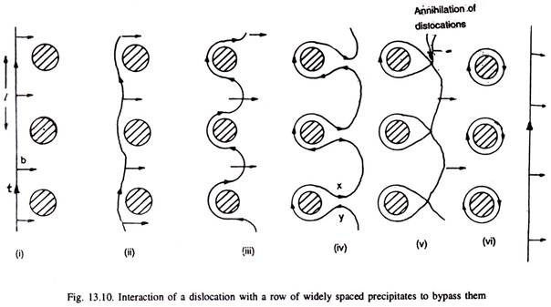
Precipitation Hardening Explained
The strength and hardness of some materials can be increased by the formation of very small particles
This is done through heat treatments
It is called “Precipitation Hardening” because the process results in very small particles, called “Precipitates”
This works because precipitates help block dislocation motion, which is an important aspect of a materials failure and properties
http://www.engineeringenotes.com/metallurgy/age-hardening-treatment/age-hardening-treatment-of-metals-metallurgy/26376
Return

Slide 38
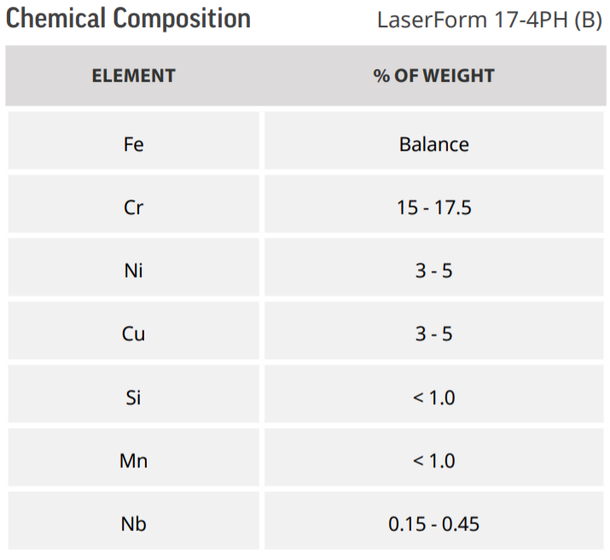
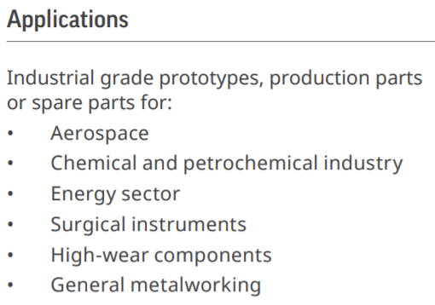
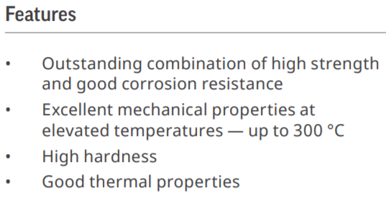
17- 4PH Stainless Steel
https://www.3dsystems.com/sites/default/files/2017-06/3D-Systems_17-4_PH_%28B%29_DMP_DATASHEET_US_A4_2017.06.21_WEB.pdf
Return

Slide 39
Arlan Ohrt

Slide 40
Standard Shapes
Summary Box
Text box 1
Outlined Text Box

Slide 41




Approved Logos

Slide 42
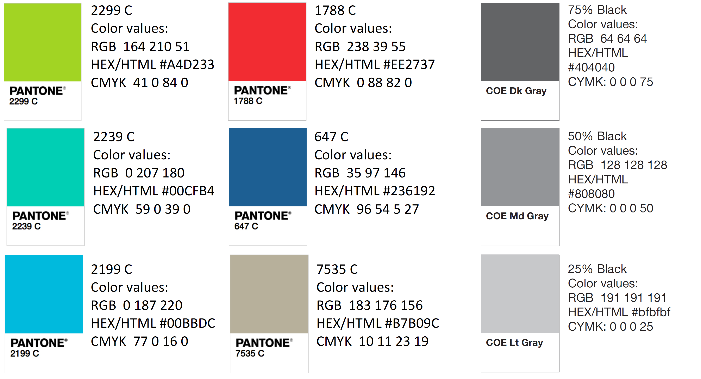
Color Palette

Slide 43
APA Tables
Category 1 | Category 2 | Category 3 | Category 4 | Category 5
Item 1
Item 2
Item 3
Item 4
 | Category 2 |  |  | Category 3
Category 1 | subcategory 1 | subcategory 2 |  | subcategory 1 | subcategory 2
Item 1
Item 2
Item 3
Item 4

